Slide 1
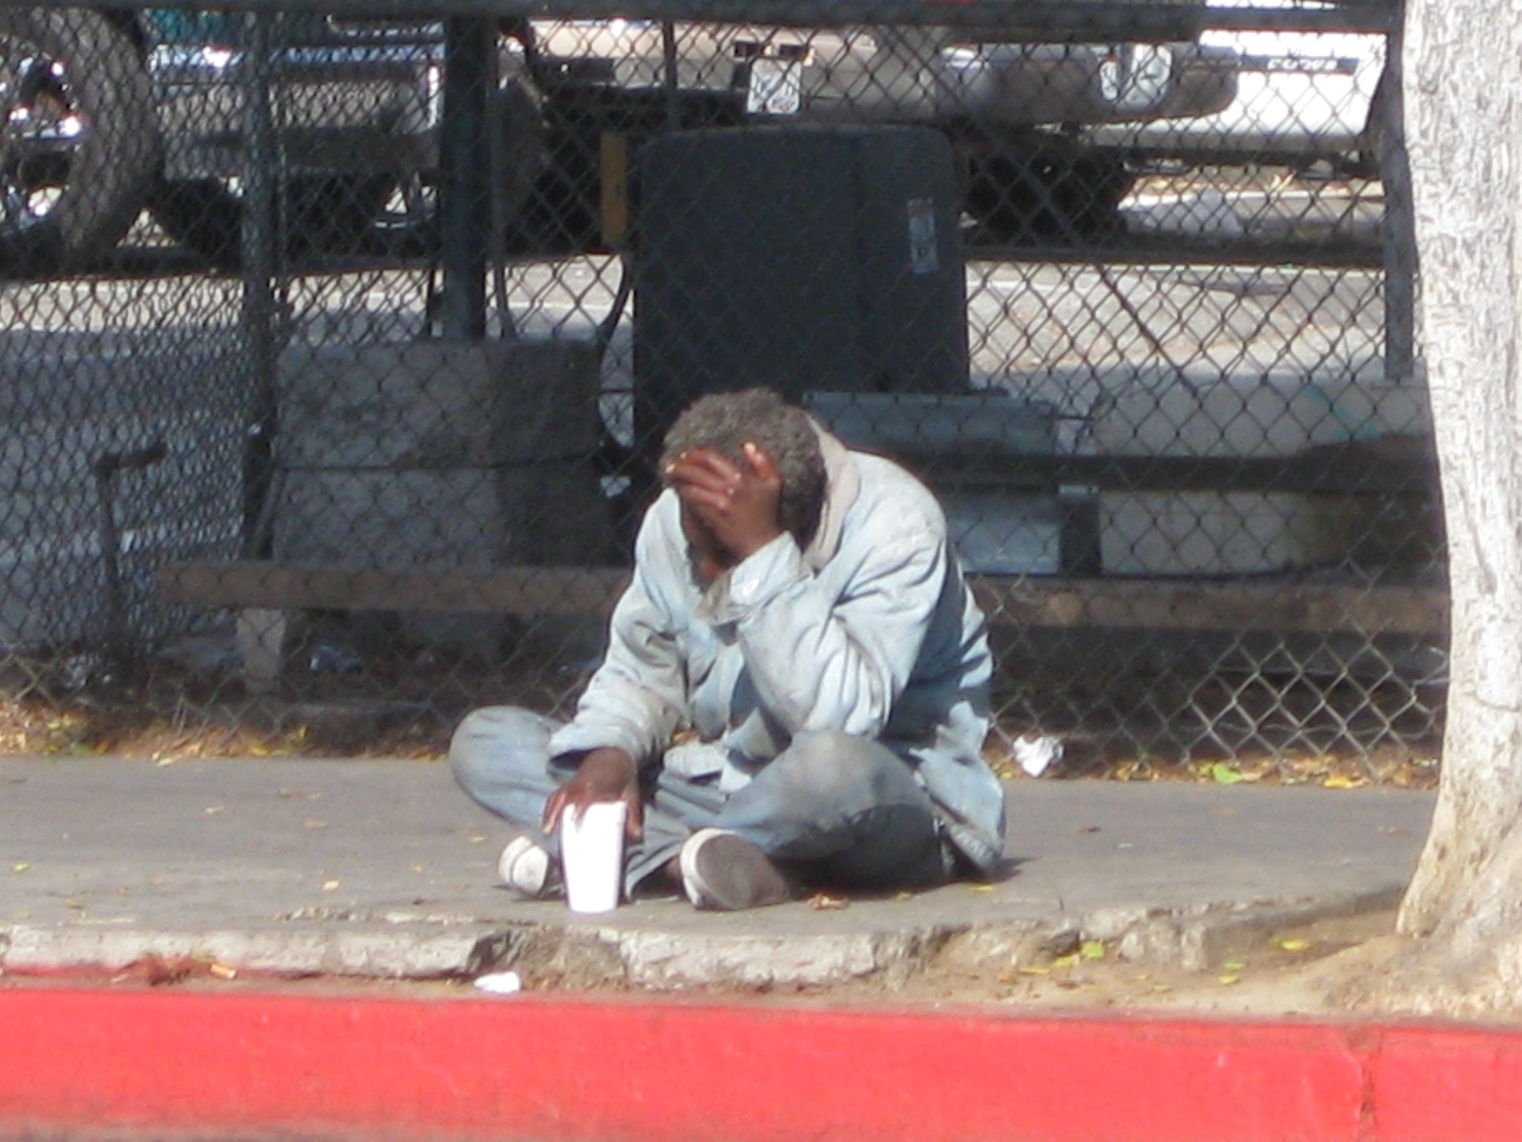
Healthcare for the Homeless
Susan Partovi, MD
Medical Director of Homeless Health Care LA
Emily DeFraites, MD, MPH
Notes:
1

Slide 2
Overview
Street Outreach to Homeless Defined
Homelessness in Los Angeles County
Harm Reduction Techniques
Extreme Medical and Psychiatric Mortality Among Homeless Clients
Who are the MOST Vulnerable Homeless?
Advocating for the Most Vulnerable: Ideas, Policies, and Solutions

Slide 3
A Good Doctor
Care and Compassion
Conscientious/Thorough
Communication
Acceptance

Slide 4
High Quality, Humane Care
“One measure of a civilized society is the care it provides for its disabled members.” E.Fuller Torrey, MD Out of the Shadows: Confronting America’s Mental Illness Crisis

Slide 5
“Street Outreach DNA”
Providing medical or psychiatric care on the street takes different skills than working in a traditional health care setting
Building rapport with patients can take weeks to months or years
Undomiciled clients tend to be isolated and disaffiliated with preexisting distrust of institutions; mentally ill clients often have a h/o negative/forced/traumatic interactions with healthcare providers and need time to build trust
Yet, for homeless clients, the clinician-client relationship is the lynchpin for further engagement and linkages to other treatment
Successful providers have “Outreach DNA”
--Empathetic, Nonjudgmental attitude, Creative, Resourceful, Flexible
--Value a collaborative approach and respect for personal autonomy, able to integrate complex psychosocial variables, willing to help with “Instrumental Needs”
--Comfortable providing care at odd/off hours and in nontraditional settings,
--Low rejection sensitivity because you will be told to “leave, get out” repeatedly but have to understand when to come back and try again

Slide 6
Street outreach
Street Medicine Goal
Find the most vulnerable for death
Find the homeless folk (usually severely mentally ill) not willing to use traditional medical home
Build relationships with them
Woo them into accepting resources e.g., housing, medical treatment, mental health treatment
International Street Medicine Consortium
Notes:
6

Slide 7
Harm Reduction (International Harm Reduction Association)
Refers to policies, programs and practices that aim to reduce the harms associated with the use of drugs in people unable or unwilling to stop using drugs. The focus is on the prevention of harm rather than on the prevention of drug use itself.
Acknowledge the significance of any positive change in one's life
Accept people as they are and avoid being judgmental conveying respect and tolerance
Meet them where they are at in their lives.

Slide 8
Harm Reduction
Don’t penalize them for their choices
Allow the patient to guide you in how they want you to treat them
What is your goal in being healthy?
What do you think you can do to make a difference?
What have you done in the past to make a difference? Was it helpful?
Eg., methadone, suboxone, dieting, exercising, cutting down on…

Slide 11
Magnitude
♀♂♀♂♀♂♀♂♀♂♀♂♀♂♀♂♀♂♀♂♀♂♀♂♀♂♀♂♀♂♀♂♀♂♀♂♀♂♀♂♀♂♀♂♀♂♀ ♀♂♀♂♀♂♀♂♀♂♀♂♀♂♀♂♀♂♀♂♀♂♀♂♀♂♀♂♀♂♀♂♀♂♀♂♀♂♀♂♀♂♀♂♀♂♀♀♂♀♂♀♂♀♂♀♂♀♂♀♂♀♂♀♂♀♂♀♂♀♂♀♂♀♂♀♂♀♂♀♂♀♂♀♂♀♂♀♂♀♂♀♂♀♀♂♀♂♀♂♀♂♀♂♀♂♀♂♀♂♀♂♀♂♀♂♀♂♀♂♀♂♀♂♀♂♀♂♀♂♀♂♀♂♀♂♀♂♀♂♀♀♂♀♂♀♂♀♂♀♂♀♂♀♂♀♂♀♂♀♂♀♂♀♂♀♂♀♂♀♂♀♂♀♂♀♂♀♂♀♂♀♂♀♂♀♂♀♀♂♀♂♀♂♀♂♀♂♀♂♀♂♀♂♀♂♀♂♀♂♀♂♀♂♀♂♀♂♀♂♀♂♀♂♀♂♀♂♀♂♀♂♀♂♀♀♂♀♂♀♂♀♂♀♂♀♂♀♂♀♂♀♂♀♂♀♂♀♂♀♂♀♂♀♂♀♂♀♂♀♂♀♂♀♂♀♂♀♂♀♂♀♀♂♀♂♀♂♀♂♀♂♀♂♀♂♀♂♀♂♀♂♀♂♀♂♀♂♀♂♀♂♀♂♀♂♀♂♀♂♀♂♀♂♀♂♀♂♀ ♀♂♀♂♀♂♀♂♀♂♀♂♀♂♀♂♀♂♀♂♀♂♀♂♀♂♀♂♀♂♀♂♀♂♀♂♀♂♀♂♀♂♀♂♀♂♀
-- In LA COUNTY, 57,737 people (1 OUT OF EVERY 250 RESIDENTS),
are homeless in LA County; 74% unsheltered
-- In NYC, 62,166 are homeless but only 5% unsheltered
-- NYC, Boston and DC have “right to shelter laws”
Notes:
11

Slide 13
HOMELESSNESS IN LOS ANGELES, 2018
53,195 homeless persons in 2018; down from 55,048 in 2017
3% decrease in homeless population
18% decrease in veteran homelessness; 16% in chronic homeless; West LA homeless decreased by 17%
Aging homeless population presents unique challenges
Over 62 year old age group increased by 22%
58% Homeless for other reasons: job loss, soaring housing costs, former foster youth,
6% Domestic Violence

Slide 14
Common Medical Conditions Among the Homeless
Dermatological
Infections/MRSA
Fungal
Infestations
Feet problems
Respiratory Infections/TB
Sexually Transmitted Infections
Dental Issues
Notes:
14

Slide 17
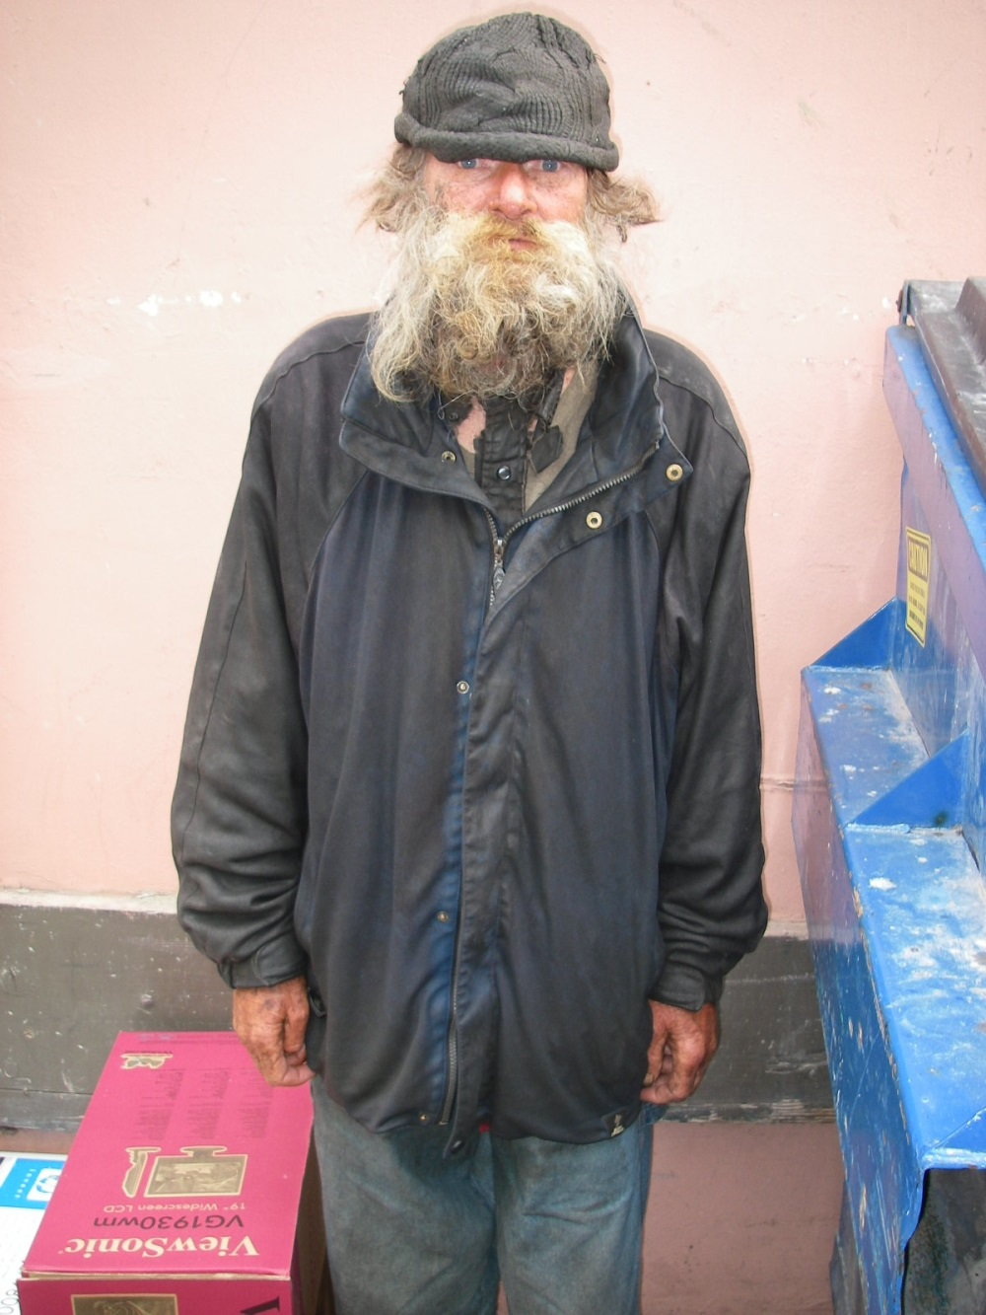
More Common Conditions
Chronic Diseases
HTN
DM
COPD
Mental Illness (30%)
Substance Use (18%)
Chronic Pain
Hepatitis C
Notes:
17

Slide 18
Common Psychiatric Diagnoses Among the Homeless
30% Severe Mental Illness (Generally defined to include Schizophrenia, Bipolar D/O, MDD)
~10% in LA County: Psychotic Disorders (could include Bipolar D/O)
10% MDD (Foster 2012)
PTSD/Trauma overrepresented
Personality Disorders—Antisocial PD overrepresented
15-18% Substance Abuse Problem (10% Dual Diagnosis)
4-7% Cognitive Disorders (Burra et al)
Incarceration leads to higher rates of homelessness

Slide 19
Homeless Mortality Research

Slide 20
119 over 5 years
In 2000, Street Team identified cohort of 119 “high-risk” street folks
Data over 5 years:
BHCHP’s EMR
Respite Program records
BMC and MGH charts
Palm Pilot database of street visits
Weekly team meetings
BHCHP: O’Connell/Roncarati/Swain
Notes:
20

Slide 21
Utilization of Medical Services by the Cohort, 1999-2003
Emergency Room Visits 18,384
(N = 119)
Notes:
21

Slide 22
Flaherty/O'Connell/Blanchfield 2.26.09
Notes:
22

Slide 23
Causes of Death (n=51)
# of deaths
BHCHP: O’Connell/Roncarati/Swain
Notes:
23

Slide 24
Risk Factors | Patients | Controls | Odds Ratio | Attribut-able Risk
HIV Infection-AIDS | 85 (12%) | 5 (1 )% | 55.8 | 0.35
HIV Infection-Symptomatic | 44 (8%) | 6 (1 )% | 17.7 | 0.14
HIV Infection-Asymptomatic | 20 (4%) | 9 (2 )% | 14.1 | 0.06
Renal Disease | 13 (2%) | 2 (0.4 )% | 18.4 | 0.07
Frostbite, hypothermia | 21 (4%) | 4 (1 )% | 8 | 0.07
Liver Disease | 31 (6%) | 5 (1 )% | 3.8 | 0.03
Arrhythmia | 26 (5%) | 6 (1 )% | 3.3 | 0.02
Seizures | 133 (24%) | 71 (13 )% | 1.7 | 0.08
Fracutre | 193 (29%) | 117 (21 )% | 1.6 | 0.11
Injection Drug Use | 206 (37%) | 98 (18 )% | 1.6 | 0.1
Alcohol dependence or abuse | 428 (89%) | 339 ( 79)% | 1.5 | 0.28
Flaherty/O'Connell/Blanchfield 2.26.09
Notes:
24

Slide 25
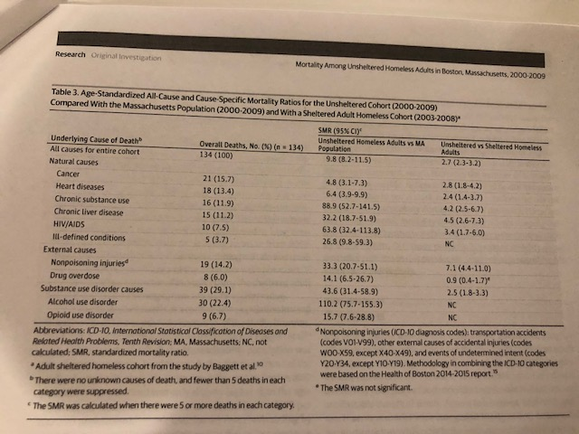

Slide 26
Causes of Mortality
AIDS
Cancer
CAD (untreated HTN, DM)
Cirrhosis
ESRD
RI
Increased risk:
H/O suicide attempt
ETOH/Cocaine use (2x)
Injection drug use (3X)
Alcohol related illness (0.25% of all deaths)
H/O Fracture
H/O cold related injury
(Archives of Internal Med ‘98)
Notes:
26

Slide 27
Homelessness Increases Mortality
Toronto – females 18 - 44 years: 10x
Boston – 3x; Average age of death was 39
Latest look at “rough sleepers” show they are 10x more likely to die. Average age of death was 53. One third died over ten years
Philadelphia – 3.5 x
New York – 4x, Average age of death was 47
Los Angeles County – Average age of death was 48 (Coalition to End Poverty and Homelessness 12/07)
Notes:
27

Slide 28
Co-Morbid Conditions
Multiple Major Medical Illness
Chronic Mental Illness
Alcohol Abuse
Notes:
28

Slide 29
Vulnerability Index: Who is at GREATEST risk of death?
Tri-Morbid (medical illness + mental illness + substance abuse)
ER over 3x/year
Hospitalized over 3x/year
Over age 60
Kidney disease
Liver disease
Heart disease
HIV/AIDS
Emphysema/Asthma
Diabetes
Cancer
Inject drug use
Alcohol abuse
H/O frostbite
Notes:
29

Slide 30
Advocating for the MOST VULNERABLE SMI HOMELESS
What is “Grave Disability”? (AKA: Why is it so useless in LAC??)
Subcommittee to Redefine Grave Disability
CA Assembly Bill 1071 did NOT pass
LPS Conservatorship for Homeless Persons Expansions
Senate Bill 1045 PASSED
Public Guardian Workgroups
Expanding Supportive Housing, B&C and Respite Care Options

Slide 31
Grave Disability Taskforce: Targeting The Most Vulnerable Homeless
A Gravely Disabled person is:
suffering from a severe mental condition
incapable of making reasonable decisions/lacks insight regarding providing for essential needs (without significant supervision and assistance from others)
persistent lack of ability to care for one’s basic needs, such as:
securing food, or
clothing, or
shelter

Slide 32
OR
Shelter:
incapable of securing adequate and appropriate shelter for the weather and one’s safety
Shows repeated and recent history of failure to maintain and sustain adequate shelter due to behaviors and symptoms of mental illness
Faces eviction despite high level mental health supports due to symptoms of mental illness
Food:
incapable of accessing and consuming life sustaining, adequate and unspoiled food and potable water ON THEIR OWN
evidence of malnutrition and/or dehydration
Unintentional substantial weight loss
OR
Clothing:
lack of clothing i.e.; nudity or partial nudity
evidence of exposure (e.g., frostbite, trench foot, hypothermia, hyperthermia)
Hygiene: covered in feces/vomit/urine/blood
Severe infestations: lice/scabies/vermin/maggots

Slide 33
GD Subcommittee ADDITION: “Lack of self-care, such that there is a dangerous worsening of serious medical conditions”
unintentional substantial weight loss
serious open wounds/serious skin infections
altered mental status/delirium/disorientation
lacks capacity to make medical decisions where no treatment would lead to substantial bodily harm*
imminent harm OR
repeated outreach and persistent refusal of care of severe chronic medical condition
But, alas, AB 1071 did not PASS in the CA State Legislator

Slide 34
Criteria for Decision-Making Capacity (After full disclosure without coercion)
Communicate a choice (Can indicate treatment choice)
Understands the relevant information (can paraphrase what medical discussion was)
Appreciates the situation and its consequences (“What do you believe is wrong with you?”)
Reason about treatment options; engages in a reasonable process of the information

Slide 35
Why Housing Matters For Health
$70 million/year inpatient costs for homeless patients
$32,000 year-over-year savings following housing
Reduction in hospital utilization by homeless before and after housing:
77% reduction in emergency room visits
77% reduction in inpatient admissions
85% reduction in inpatient days
Notes:
35

Slide 36
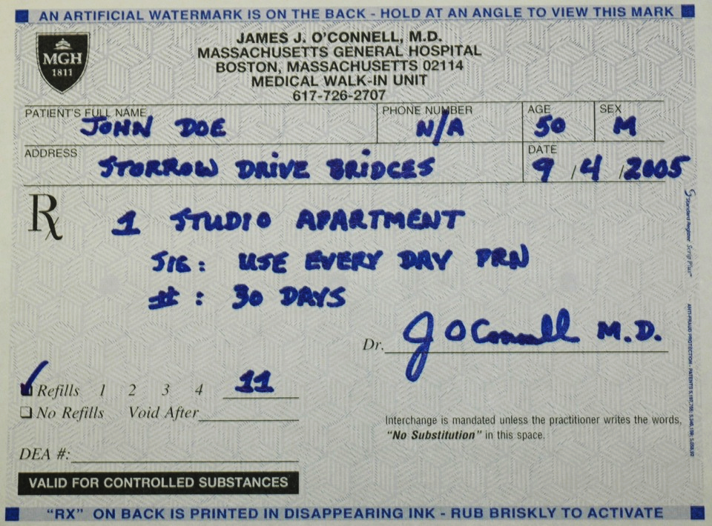
Notes:
36

Slide 37
DIVERSITY OF SUPPORTED HOUSING FOR DIFFERENT NEEDS
Recuperative Care
Care for the homeless who need to recuperate from a hospital stay or illness
May also be used for the homeless needing stable housing/food/rest during chemotherapy or for pre-procedures/pre-surgery
Emergency Homeless Shelters
Rapid rehousing, group living, security,
Board & Care Residences (generally for mentally ill)
Provides medication administration, three meals/day, 24 hour supervision
Project-Based Supportive Housing
Independent living apts with ONSITE services (Case Management, coordination of food/ transportation/social services)
Scatter-Site Permanent Supportive Housing
Random site independent living which may include FSP/AOT Supports
Notes:
37

Slide 38
Senate Bill 1045: Advocacy WORKS!!
---New type of pilot conservatorship for SD, LA, SF counties that focuses on providing supportive housing with wraparound services to the most vulnerable Californians living on the streets.
--In order to be considered for conservatorship, an individual must be chronically homeless and suffering from acute mental illness or severe substance abuse disorder such that those co-occurring conditions have resulted in that individual frequently visiting the emergency room, being frequently detained by police under a 5150, or frequently held for psychiatric evaluation and treatment (>8 times).
--Under this bill, the director of a county mental health or social services department, the county sheriff, the director of a hospital or emergency health facility, or the head of a facility providing intensive services can recommend to the county that a person be conserved.
--This is allow another avenue for known HIGH RISK, HIGH UTILIZING clients to be mandated into wraparound, supportive services to prevent homelessness

Slide 39
Be A Good Doctor

Slide 40
A Good County: Can Los Angeles rise to the challenge?
“One measure of a civilized society is the care it provides for its disabled members.”
-E. Fuller Torrey, MD Out of the Shadows: Confronting America’s Mental Illness Crisis

